Slide 1


ADAS Testing & Reconstruction
C2413
Notes:
Course Header

Slide 2
The information, representations, opinions, and recommendations contained in the lectures and hardcopy material are those of the instructor(s) and not of SAE International. This material is copyright protected. No part of this program may be reproduced, stored in a retrieval system, transmitted, in any form or by any means, electronic, mechanical, photocopying, recording, or otherwise, or used for text and data mining, AI training, or similar technologies, without the prior written permission of the instructor(s).
Notes:
Copyright

Slide 3

Course Objectives
Design an ADAS testing program
Identify key concepts in the ADAS data acquisition process such as GNSS, RTK,
IMU, and CAN
Apply the technology to implement
ADAS tests
Conduct hands-on testing of ADAS in passenger vehicles and/or commercial vehicles
Analyze and interpret ADAS and vehicle
CAN data in different scenarios
Notes:
Course Objectives

Slide 4
Course Agenda
Day 1:
Topics
Introduction to Course – Schedule, Objectives, Format (30 minutes)
Intro to Testing, ADAS, & TTC/TTC2 (SH 30 minutes)
Overview of VBOX Data Acquisition (JL 60 min)
Break
Overview of VBOX Test Suite for Data Analysis (JL 60 min)
Track Safety (SH 30 min)
Lunch
Practice Driving (SH 90 min) | Analyzing Data (JL 90 min)
Break
Analyzing Data (JL 90 min) | Practice Driving (SH 90 min)
Closing
Notes:
Agenda

Slide 5
Course Agenda
Day 2:
Topics
Day 2 – Let’s get started (15 min)
Track Testing (SH 90 min) | Analyzing Data (JL 90 min)
Break
Analyzing Data (JL 90 min) | Track Testing (SH 90 min)
Lunch
Track Testing (SH 90 min) | Analyzing Data (JL 90 min)
Break
Analyzing Data (JL 90 min) | Track Testing (SH 90 min)
Closing
Notes:
Agenda

Slide 6
Course Agenda
Day 3:
Topics
Day 3 – Let’s get started (15 min)
Track Testing (SH 90 min) | Analyzing Data – Prep (JL 90 min)
Break
Analyzing Data - Prep (JL 90 min) | Track Testing (SH 90 min)
Lunch
Group Presentation
Closing – Assessment and Evaluation
Notes:
Agenda

Slide 7
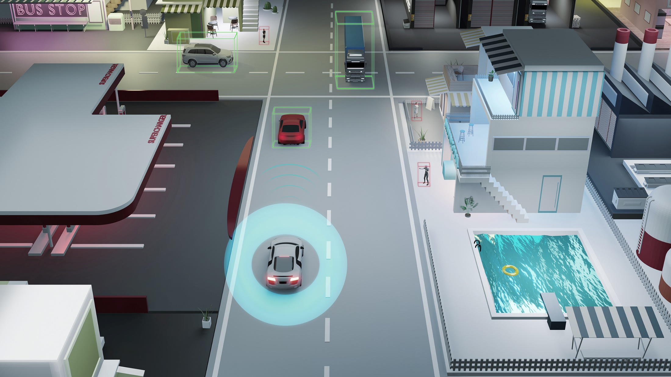
Module 1
Introduction to ADAS Testing and Reconstruction
Notes:
Module/Section Header

Slide 8
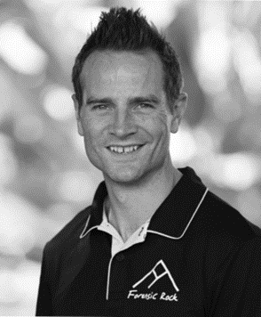
About the Instructor
Shawn Harrington
Principal & Founder of Forensic Rock
17+ years experience in Accident Reconstruction & ADAS
Testified in State & Federal Courts throughout Country
Has CDL
Volunteer Firefighter
Published in SAE, Collision Magazine
Actively researching, publishing, and presenting in the areas of ADAS on
heavy truck and passenger vehicles

Slide 9

About the Instructor
Jim Lau
Technical Director at Racelogic
Employed by VBOX/Racelogic since 2005
Automotive CAN Expert
ADAS Testing Expert

Slide 10

Who are YOU?
Information to share:
Name and organization
Position and role
Questions you hope to have addressed in the class
Notes:
Who are you?

Slide 11

Expectations for You
Our expectations are that you will:
Actively participate in discussion
and activities
Gain new skills and build on existing ones
Reflect on your own experiences
Think about how you’d use the skills and concepts you learn in this course in your job
Notes:
Expectations

Slide 12
Module Objectives
Identify the foundational technologies
of ADAS
Recognize the various ADAS in vehicles
Explain an overview of SAE Levels 1 to 5
Identify and define time to collision and time to collision 2
List what agencies are currently testing ADAS in vehicles

Slide 13
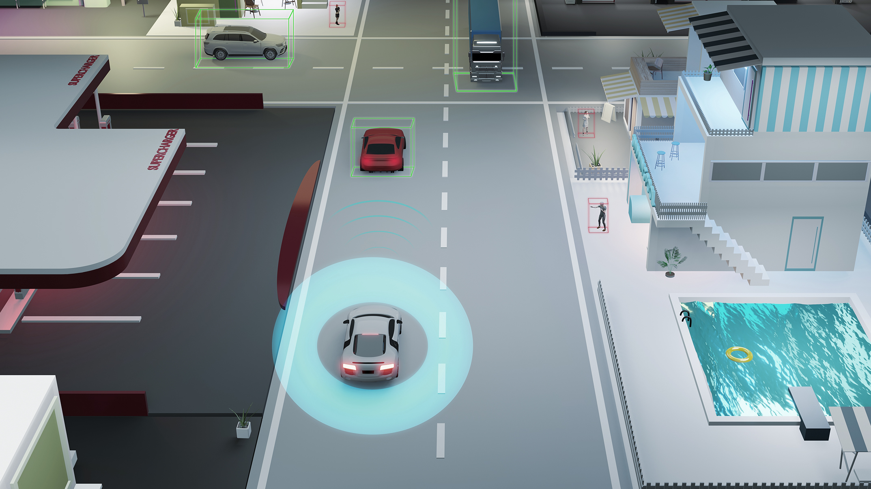
The beginning was…
Driver Assistance Systems

Slide 14



Driver Assistance Systems (DAS)
Antilock Braking System (ABS)
Traction Control System (TCS)
Electronic Stability Control (ESC)

Slide 15
Define ADAS:
ADAS stands for Advanced Driver Assistance Systems
ADAS leverages DAS technology like ABS and ESC, so it is
important to understand this technology.

Slide 16

Antilock Braking Systems (ABS)
First developed for aircraft in the 1920s
Implemented on motorcycles in the 1950s
Were first equipped on the Ford Zodiac in the 1960s – COST!
Cadillac added ABS in the 1970s as a premium add-on
Finally became a mainstream safety feature in the 1990s
Antilock Braking System (ABS)

Slide 17
TCS & ESC
Traction Control System (TCS)
Electronic Stability Control (ESC)
These systems help keep the vehicle under control while the vehicle is accelerating. ESC keeps the vehicle headed in the driver's intended direction, even when the vehicle nears or exceeds the limits of road traction.

Slide 18
Let’s not forget
Cruise Control!

Slide 19
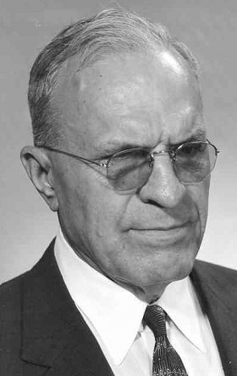
Cruise Control (CC)
Engineer Ralph Teetor developed in the 1940s
Wanted to fix his lawyer’s jerky driving habits!
Patented a “Speed Control Device” in 1950
The 1958 Chrysler Imperial was first with CC
Every major manufacturer offered it by the 1960s
By the 1990s, cruise control was a very popular feature in passenger vehicles
Engineer Ralph Teetor was
not only brilliant, but blind!
Source: https://360.here.com/the-evolution-of-cruise-control

Slide 20
Types of Driver Assistance Systems
Driver Assistance Systems
ABS
ESC
CC

Slide 21
Types of Driver Assistance Systems
ADAS
Driver Assistance Systems
ABS
ESC
CC

Slide 22
Types of Driver Assistance Systems
ADAS
ACC
AEB
LKAS
Driver Assistance Systems
ABS
ESC
CC

Slide 23
Types of Driver Assistance Systems
ADAS
ACC
AEB
LKAS
HBSS
FCW
LDW
Driver Assistance Systems
ABS
ESC
CC

Slide 24
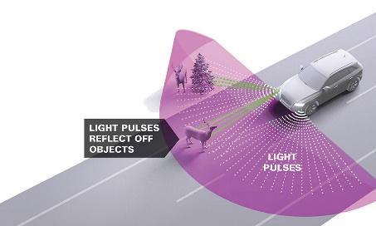
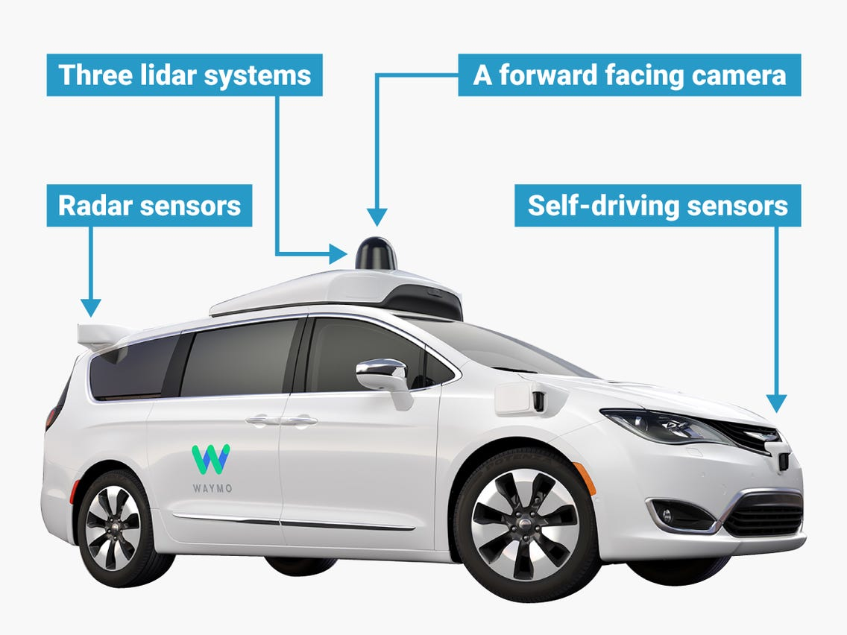
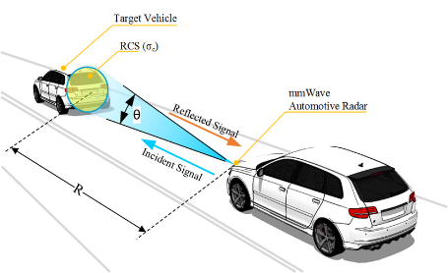
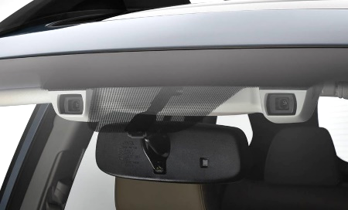
Background: Technologies Supporting ADAS
Light Detection and
Ranging (LiDAR)
Radar
Camera
Source: Google Images

Slide 25
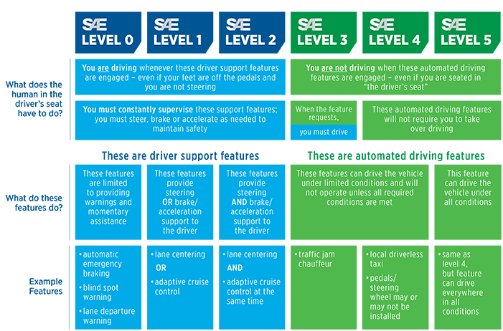
SAE J3016: Levels of Driving Automation

Slide 26
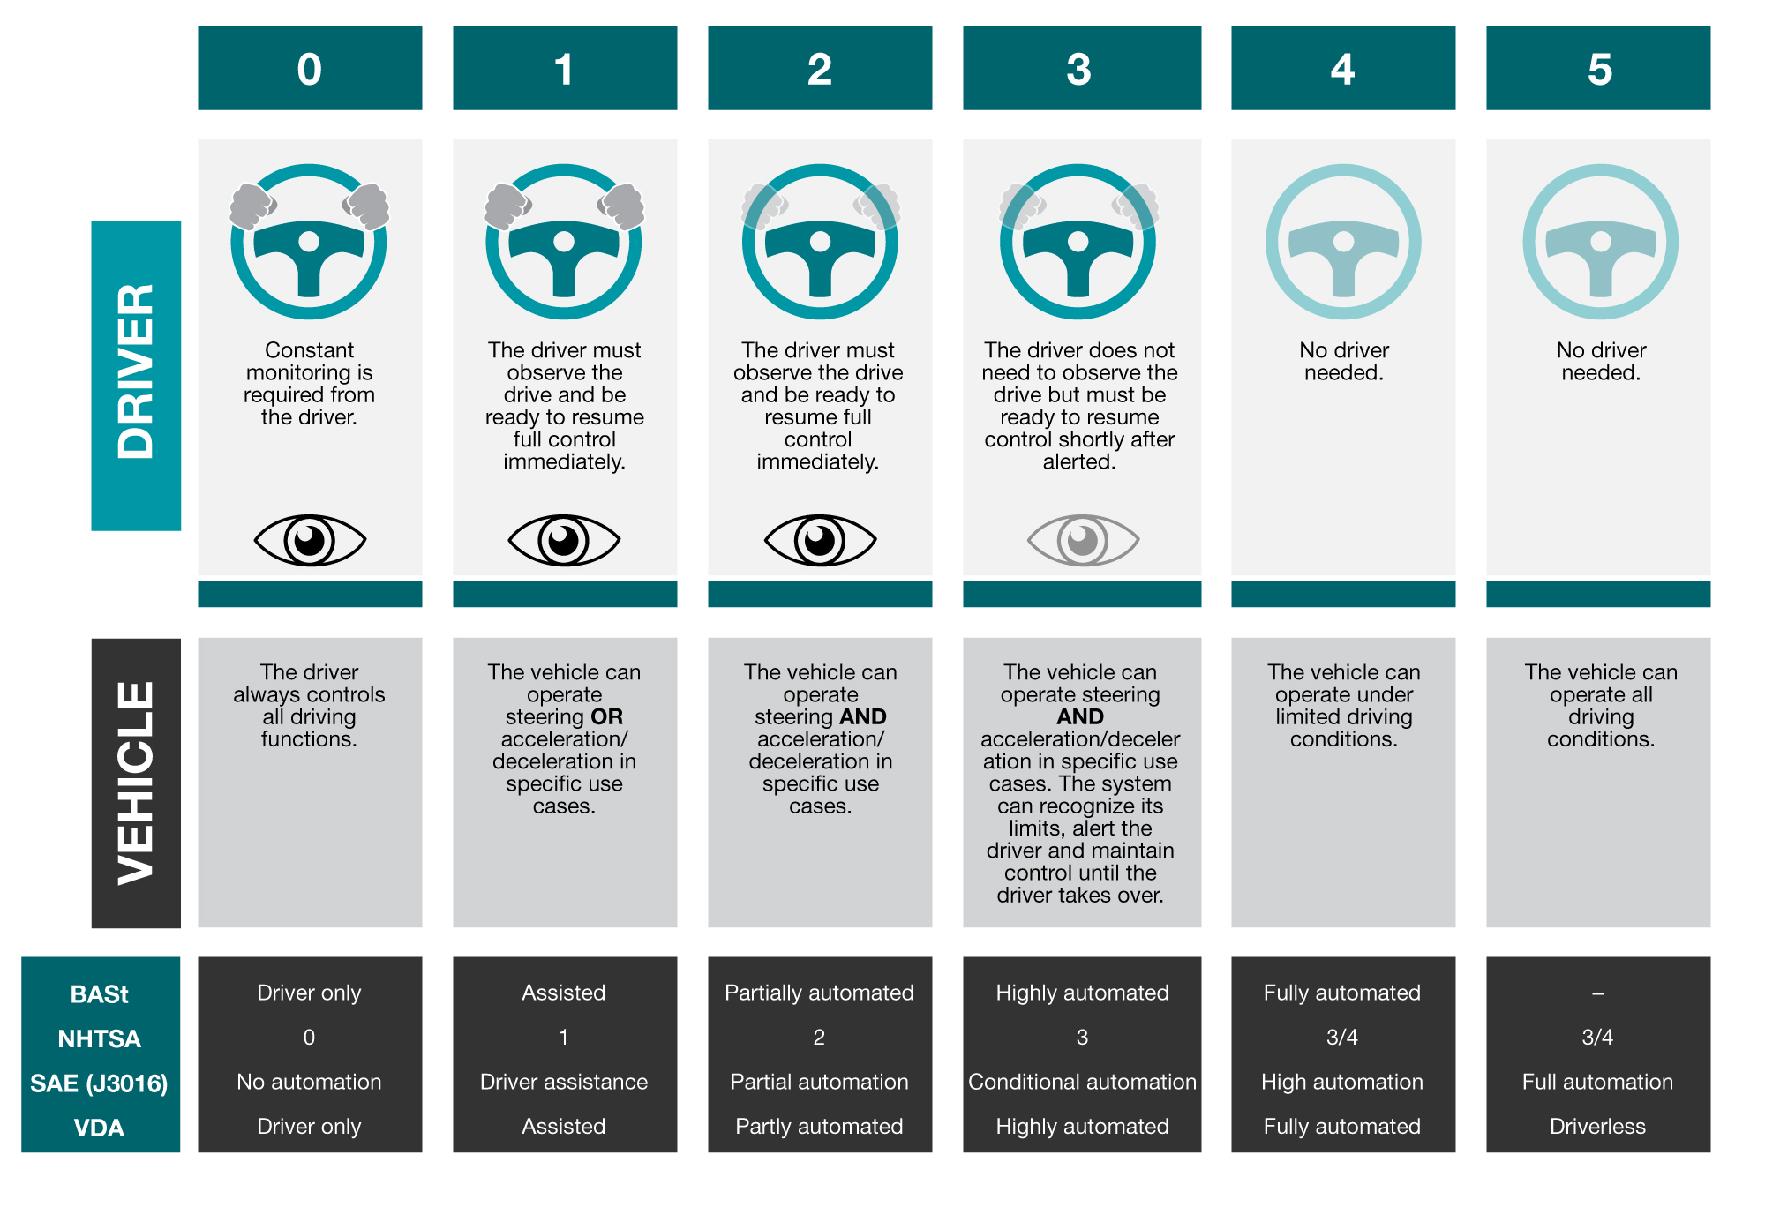
The 6 Levels of Autonomous Driving
ADAS
AUTONOMOUS

Slide 27

The 6 Levels of Autonomous Driving
0
All Driver

Slide 28
The 6 Levels of Autonomous Driving
0
Vehicle steers
OR accelerates

Slide 29

The 6 Levels of Autonomous Driving
1
Vehicle steers
AND accelerates

Slide 30
The 6 Levels of Autonomous Driving
1
Vehicle steers AND accelerates
Hands on Wheel!

Slide 31
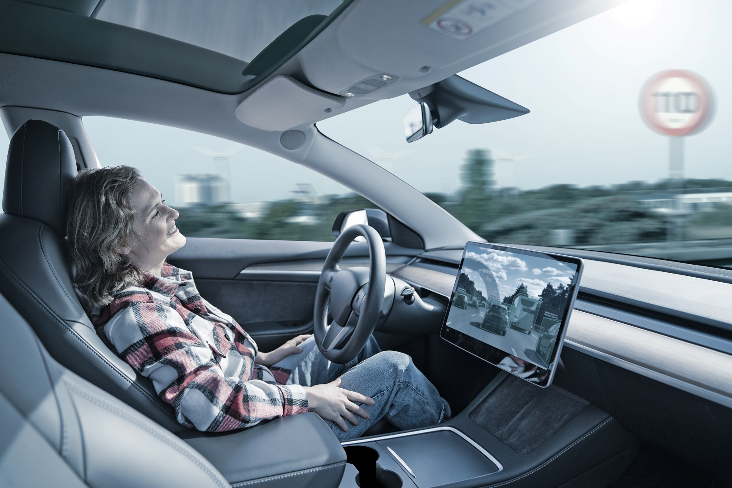
The 6 Levels of Autonomous Driving
2
Vehicle steers
AND accelerates

Slide 32
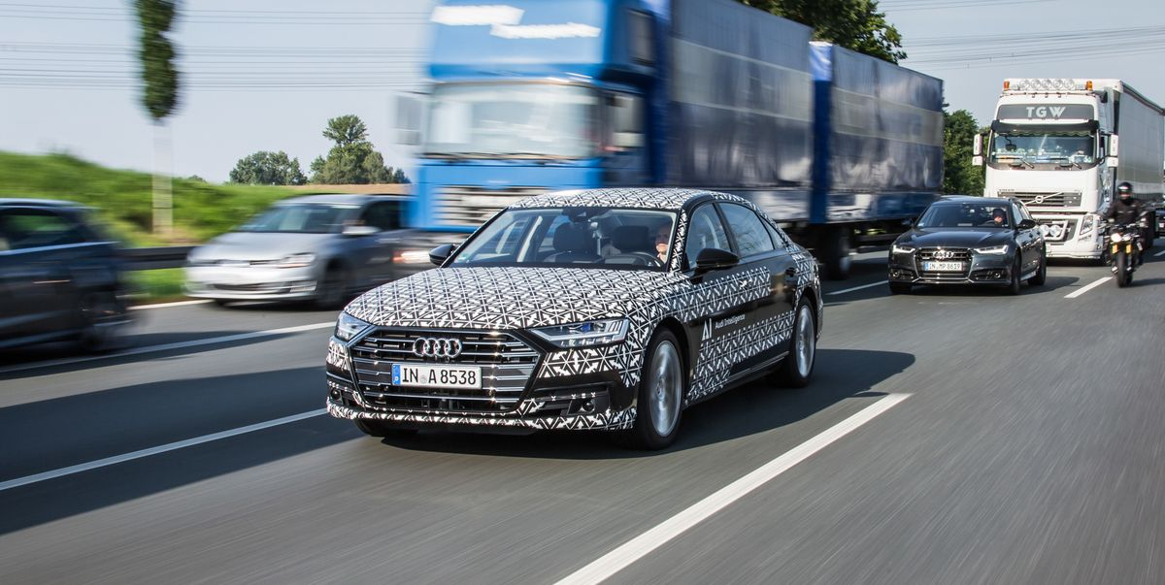
The 6 Levels of Autonomous Driving
3
Vehicle steers
AND accelerates
The issue of “handing over” control arrives
Can take over
but knows limits

Slide 33
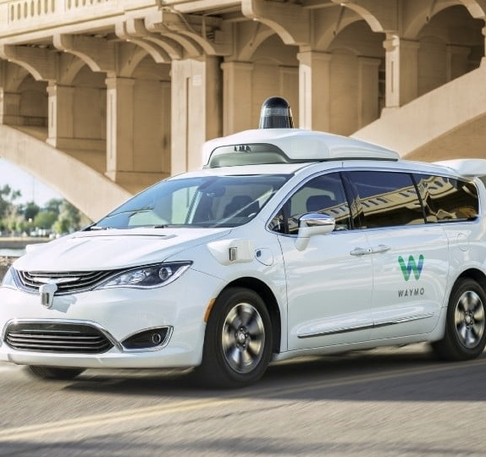
The 6 Levels of Autonomous Driving
4
Vehicle driven
by the robot in certain areas and certain weather

Slide 34
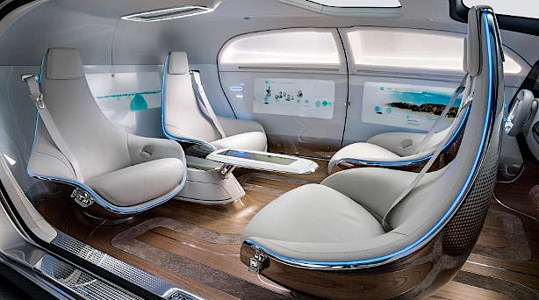
The 6 Levels of Autonomous Driving
5
Vehicle driven
by the robot ANYWHERE –
ANY WEATHER

Slide 35
Discussion Point:
Who is testing these ADAS?

Slide 36

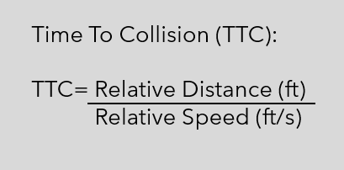
Background –Testing - FCW
Government funded
Pass/Fail type tests
FCW test data not easily publicly available
Does not evaluate AEB/speed reduction
Test vehicle speed (mph) | Target vehicle status | Pass/Fail criteria
45 | Stopped | TTC at least 2.1 s
 | Decelerating | TTC at least 2.4 s
 | Slow moving | TTC at least 2.0 s
National Highway Traffic Safety Administration

Slide 37
Background –Testing - FCW
Government funded
Pass/Fail type tests
FCW test data not easily publicly available
Does not evaluate AEB/speed reduction
WAIT! TTC
Test vehicle speed (mph) | Target vehicle status | Pass/Fail criteria
45 | Stopped | TTC at least 2.1 s
 | Decelerating | TTC at least 2.4 s
 | Slow moving | TTC at least 2.0 s
National Highway Traffic Safety Administration

Slide 38
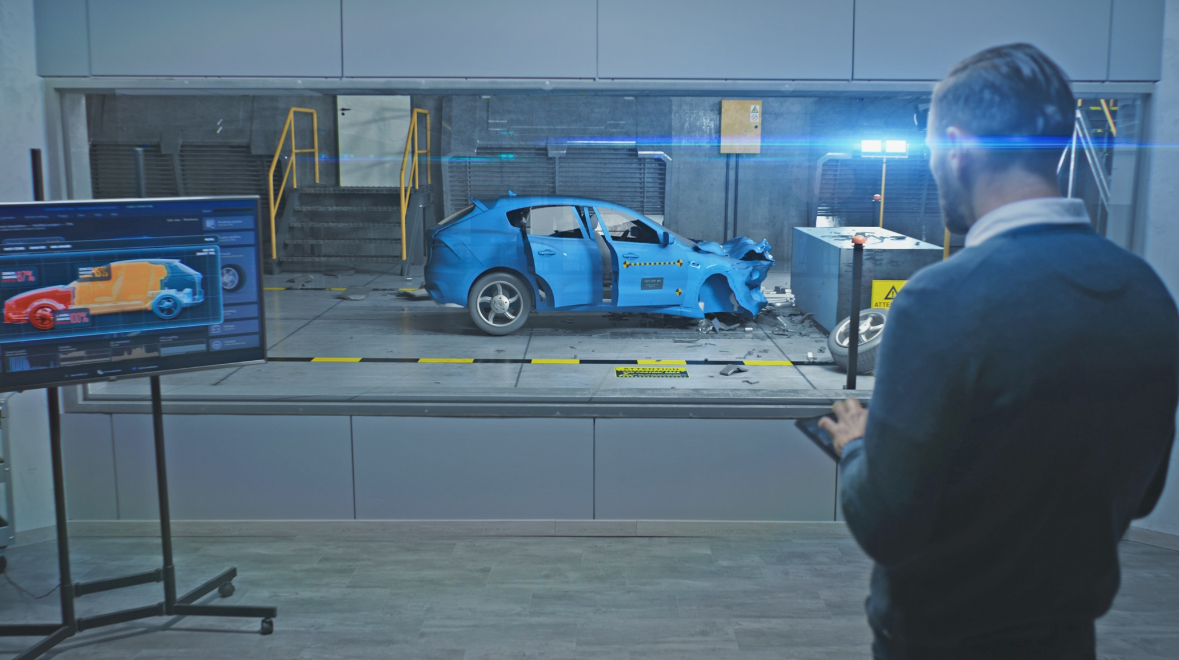
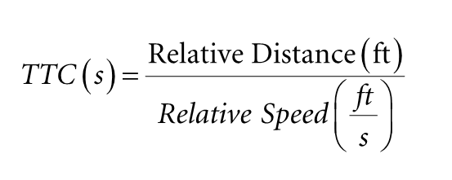
Definition of Time to Collision (TTC)

Slide 39
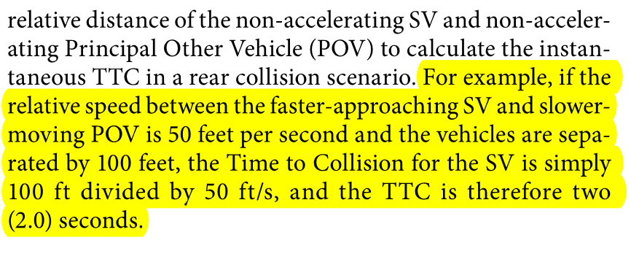
Definition of Time to Collision (TTC)

Slide 40
Discussion Point:
TTC2 becomes significantly
more complicated as compared
to TTC … why?

Slide 41
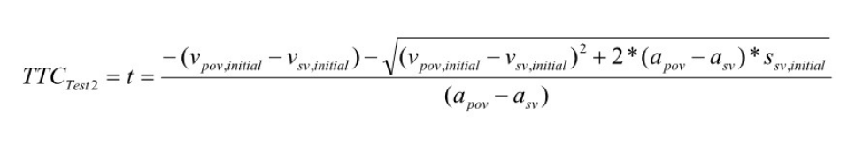
Definition of Time to Collision 2 (TTCTest2)

Slide 42
Definition of Time to Collision 2 (TTCTest2)
The issue is relative acceleration.

Slide 43
Background –Testing - FCW
Government funded
Pass/Fail type tests
FCW test data not easily publicly available
Does not evaluate AEB/speed reduction
Test vehicle speed (mph) | Target vehicle status | Pass/Fail criteria
45 | 1.Stopped | TTC at least 2.1 s
 | 2. Decelerating | TTC2 at least 2.4 s
 | 3. Slow moving | TTC at least 2.0 s
National Highway Traffic Safety Administration

Slide 44

Background – Testing - FCW
Private, Nonprofit, funded by insurance companies
Star rating-based evaluation
Test data publicly available
Evaluates FCW & AEB/speed reduction
 | 12 mph tests |  |  | 25 mph tests |  |  |  | FCW
Speed reduction (mph) | <5 | 5 to 9 | >10 | <5 | 5 to 9 | 10 to 21 | >22 | NA
Points | 0 | 1 | 2 | 0 | 1 | 2 | 3 | 1

Slide 45

Background – Testing – FCW

Slide 46
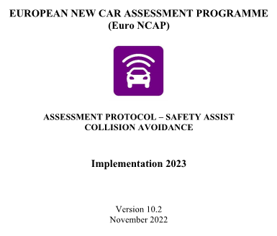
Background – Testing – FCW

Slide 47
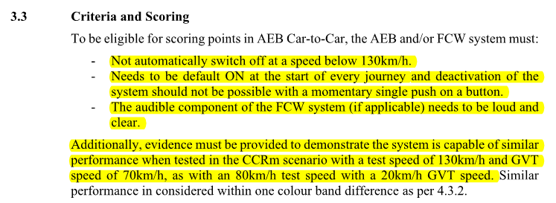
Background – Testing – FCW

Slide 48
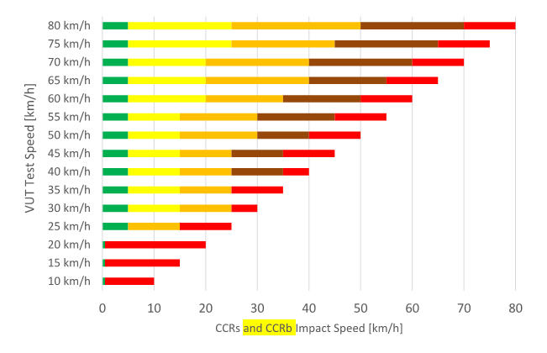
Background – Testing – FCW
80 km/h ~= 50 mph
50 km/h ~= 31 mph
20 km/h ~= 12 mph

Slide 49
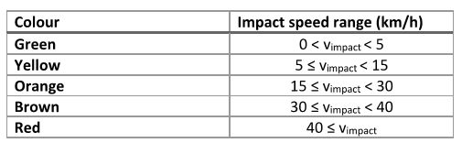
Background – Testing – FCW
5 km/h ~= 3 mph
15 km/h ~= 9 mph

Slide 50

Who else is testing FCW & AEB?

Slide 51
Discussion Point:
Auto Manufacturers &
Suppliers – Is this public?

Slide 52
Any Questions?
Notes:
Any questions?

Slide 53
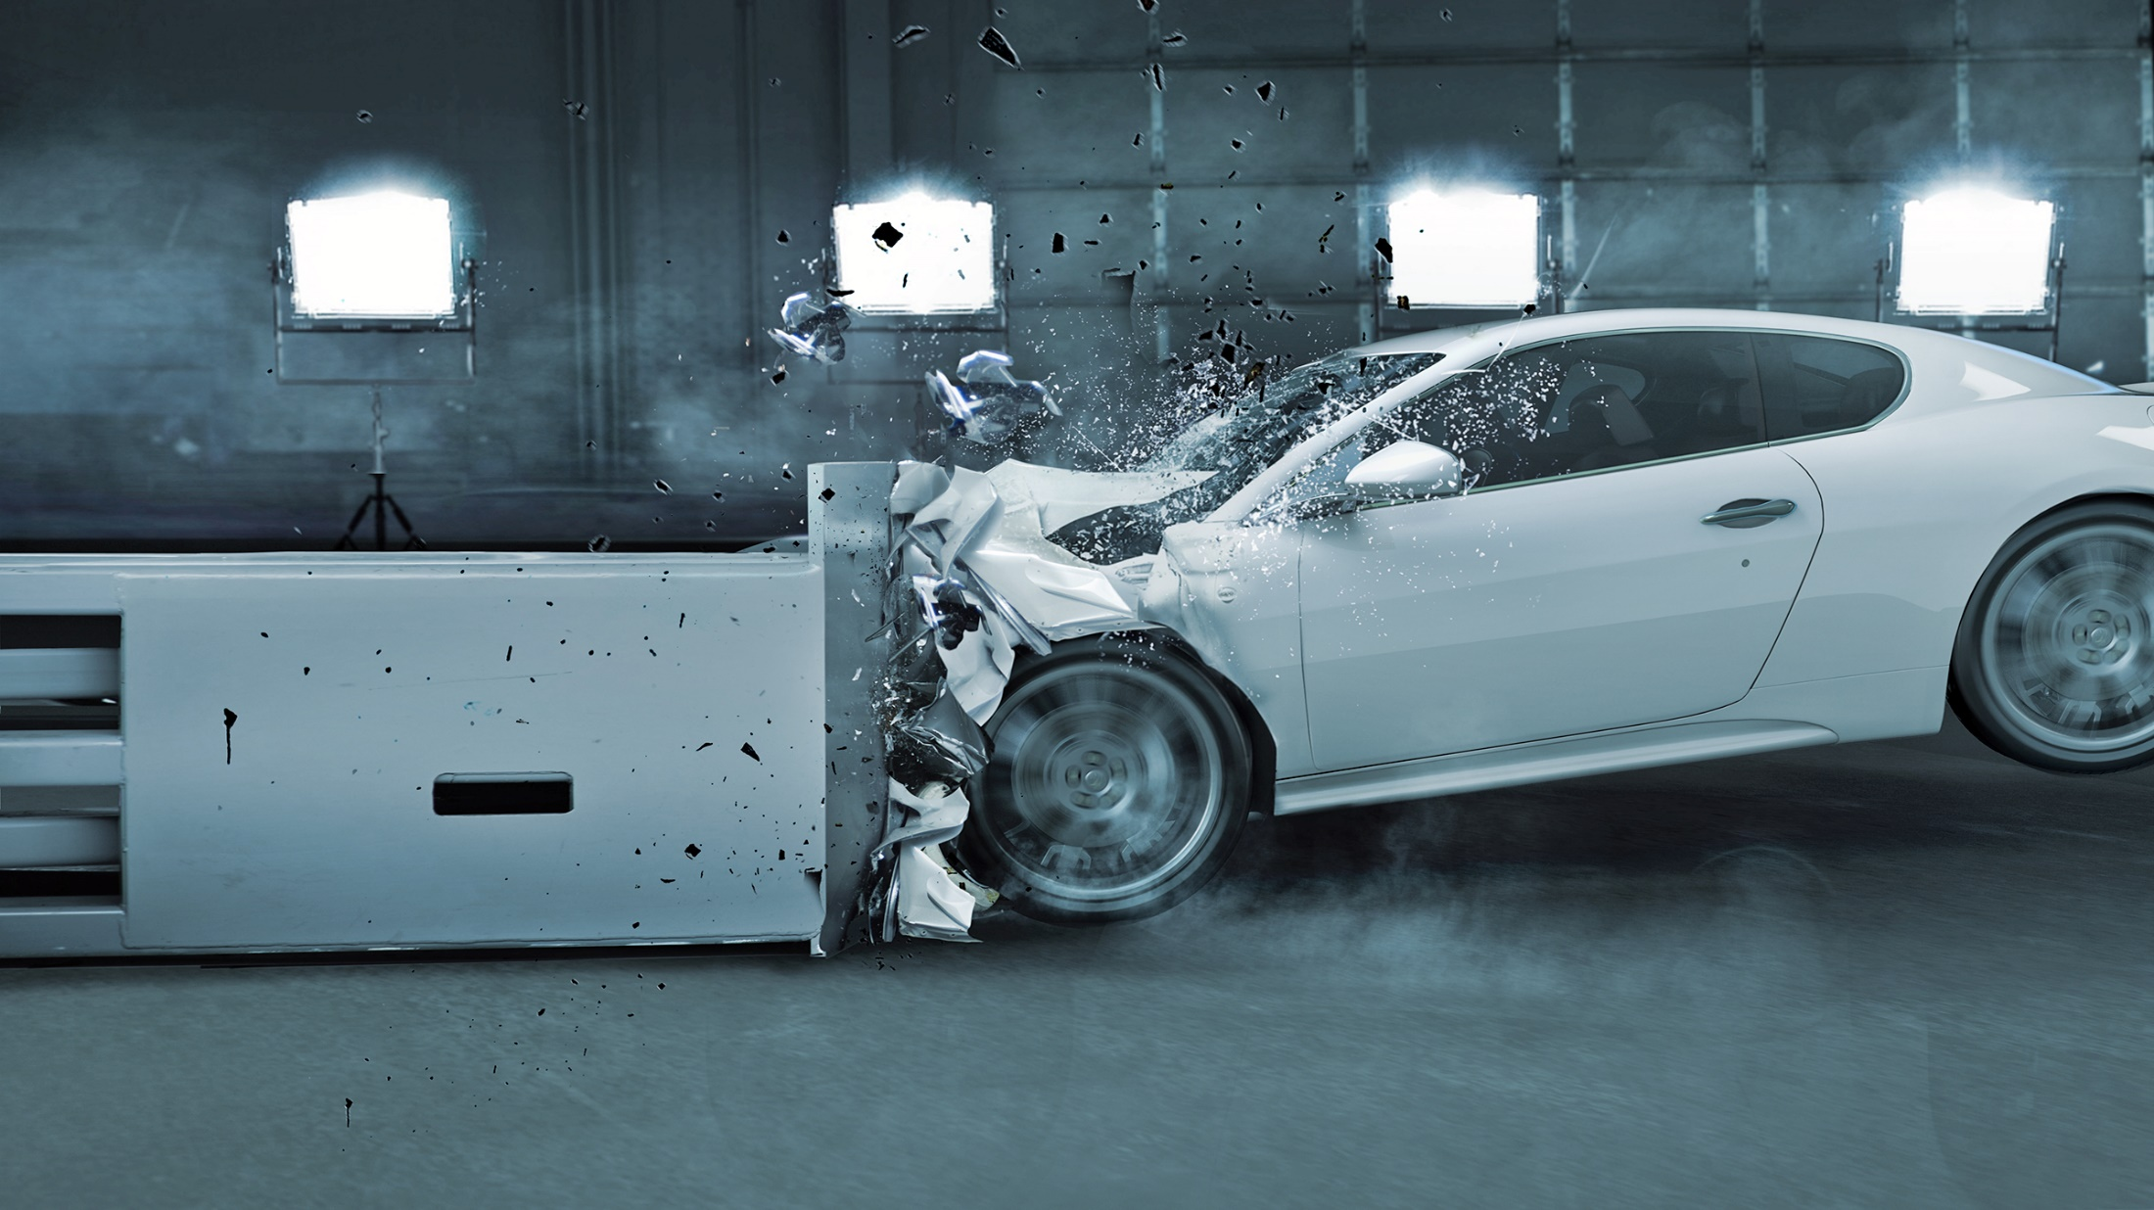
Module 2
Overview of Test Vehicles & ADAS
Notes:
This module is an introduction to the vehicles that are being tested for this offering.
This module will also provide information on the ADAS in each vehicle.

Slide 54
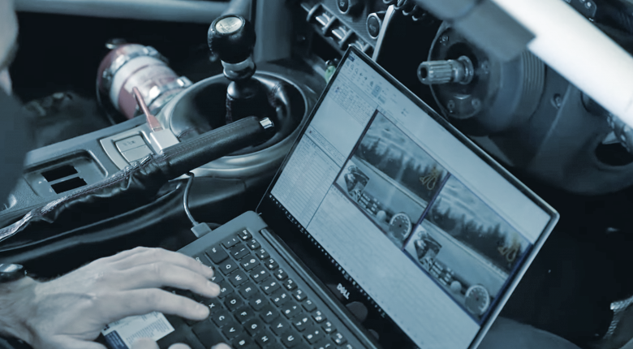
Module 3
Overview of VBOX Data Acquisition and Setup on Vehicles
Notes:
Module/Section Header

Slide 55
Module 3 Objectives
List the steps involved in collecting Advanced Driver Assistance Systems (ADAS) test data, including instrumenting vehicles and logging data to a memory card for further analysis.​
Recognize technologies such as GNSS, RTK, and IMU used in vehicle data acquisition, including the capabilities and configurations
of the VBOX 4 and associated sensors.​
Describe how to set up the equipment and integrate data from vehicle CAN bus, GNSS, and other sensors to facilitate accurate
testing and analysis, including video
logging with data overlay.​
Notes:
Module Objectives

Slide 56
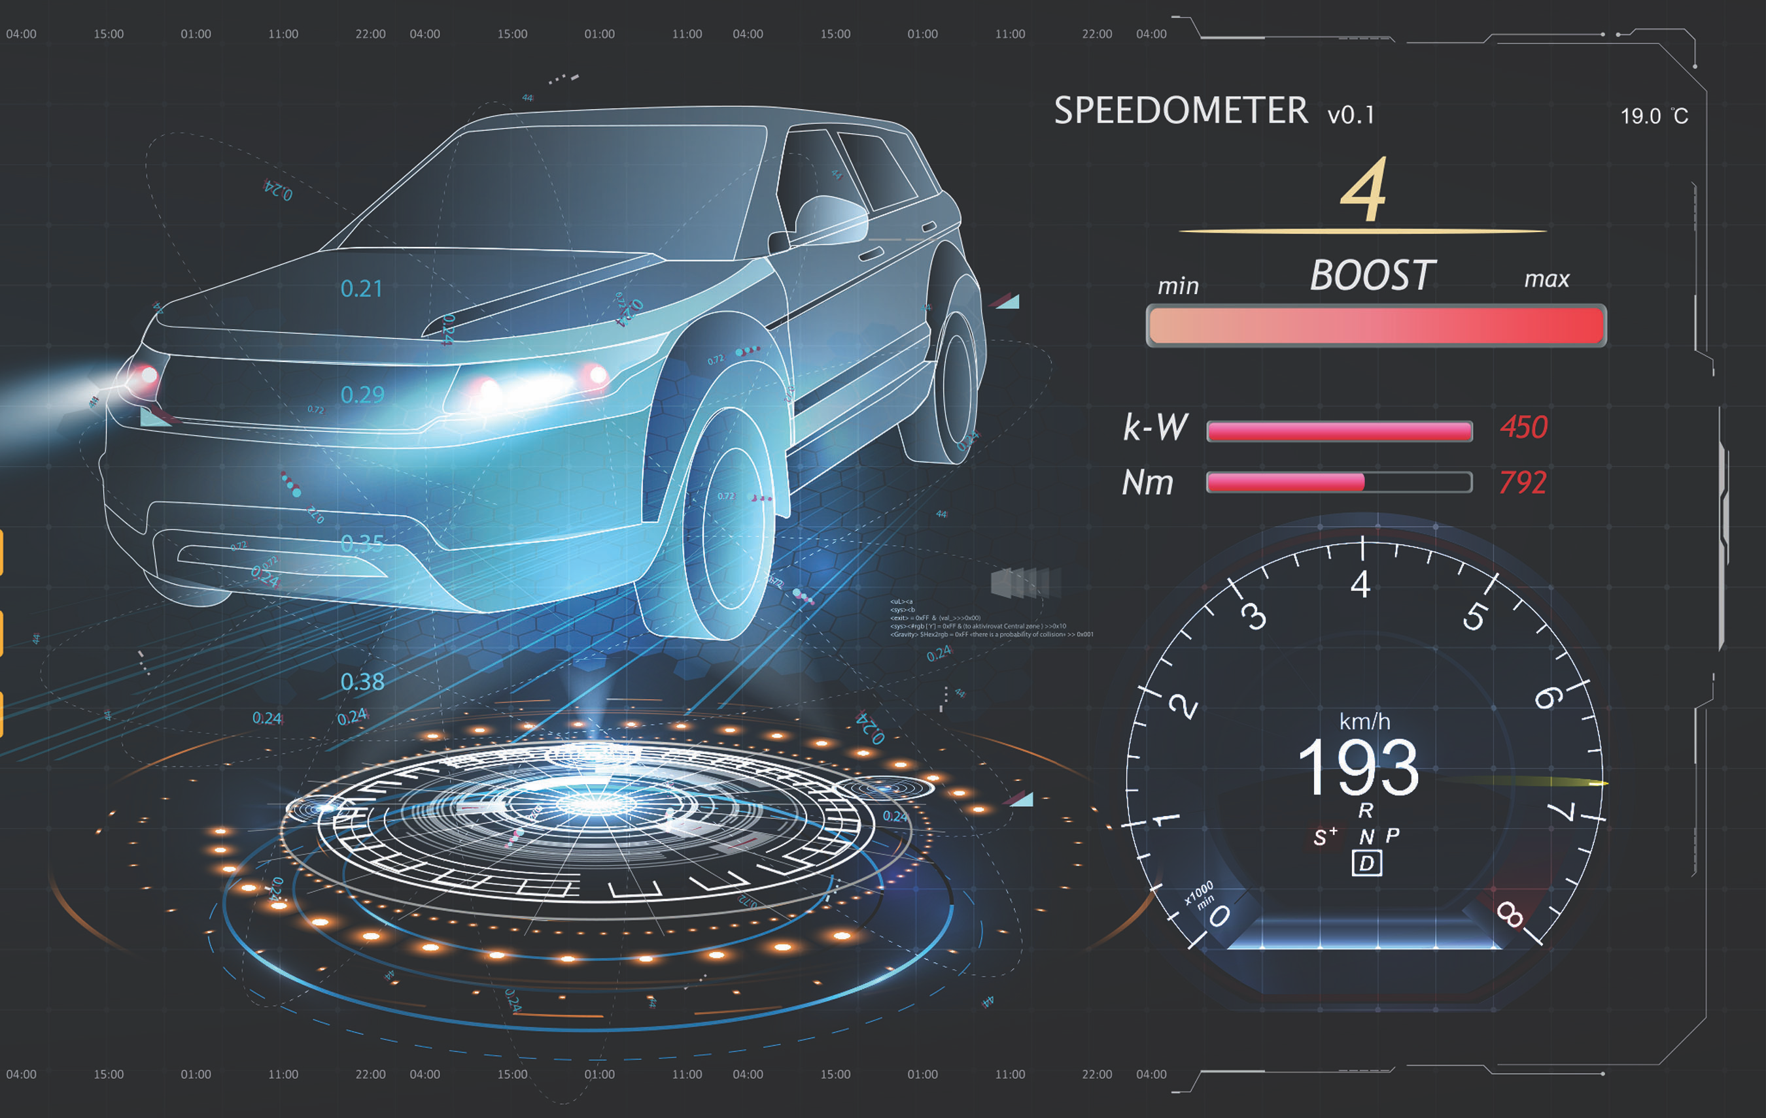
Steps to Collect ADAS Test Data
These are the steps used to collect ADAS test data:
This module is about step two, collecting data. We instrument one or more vehicles, collect the data we need by logging in to a memory card in the vehicle and viewing tests live, then have data files to analyze further.
Design Test
Collect Data
Analyze Results

Slide 57
Key Technologies
GNSS
Global Satellite Navigation System
RTK
Real-Time
Kinematics
IMU
Inertial
Measurement Unit

Slide 58






GNSS (Global Satellite Navigation System)
GPS, GLONASS, Galileo, BeiDou satellite
constellations
GNSS provides Position, Speed, Heading, Time
Speed is measured from Doppler shift, not position
Distance is calculated
from speed
For some tests, this is all that
is needed
More info:
How does it
work? - GPS Accuracy

Slide 59
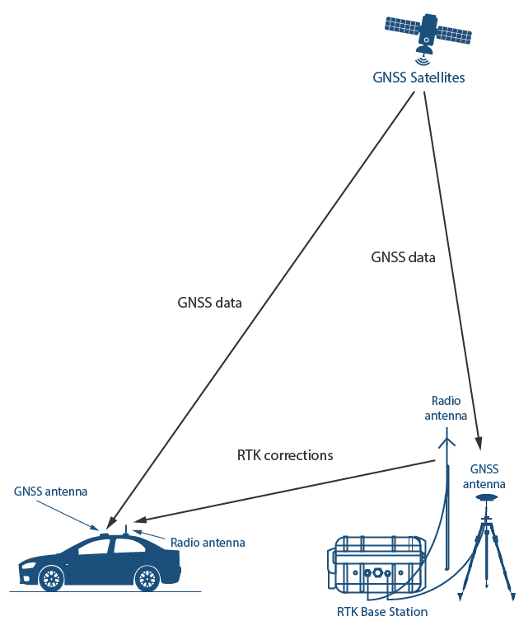
RTK (Real-Time Kinematics)
Improves positional accuracy to ~2cm, suitable for position-based tests:
A Base Station has a known location and compares that against the current position it reads from the sky and calculates the difference (correction)
for latitude, longitude, and height.
There are industry-standard protocols for DGNSS correction messages.
Most devices use RTCMv3.
A GNSS device needs a good view of the sky and reliable correction messages to achieve 2cm positional accuracy
More info: Real Time Kinematic (RTK)

Slide 60
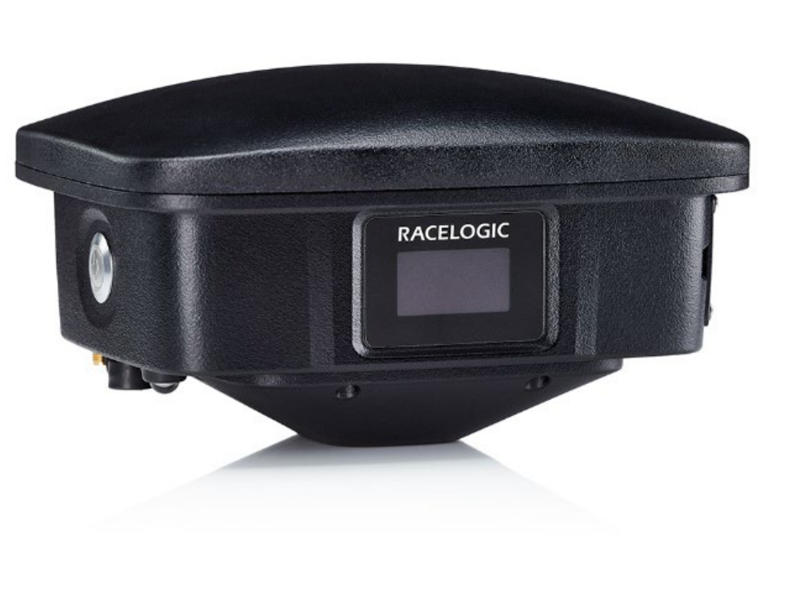
RTK Base Station
An RTK Base Station can be set up trackside
with local radios.
Pros:
  Good for track tests
  No need for mobile data coverage
  No subscription cost
  Control over the system, can be deployed
  anywhere
Cons:
  Purchase cost
  Only one, not suitable for on-highway testing
  Limited by radio range
  Setup/teardown time
One Base Station provides corrections on a radio transmitter for as many receivers as needed.

Slide 61
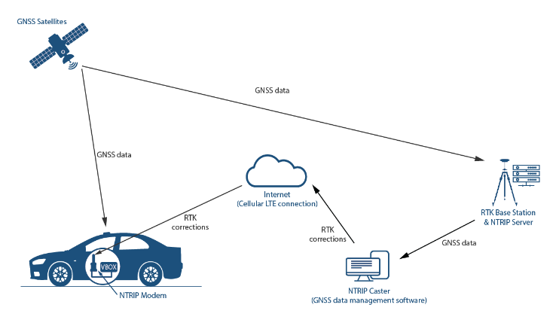
NTRIP (Network Transmission of RTK over IP)
NTRIP is a protocol to get corrections over the internet.
Pros:
Many states have free networks of Base Stations already
VRS (Virtual Reference Station) allows for a blend of corrections from different locations to the rover, so it can maintain RTK accuracy across a state or region
  In this mode, the device sends its location to the server every 5 seconds to get a specific correction for that location
Cons:
Not available everywhere
Requires cell service and an active data plan for each device
May require paid subscription

Slide 62
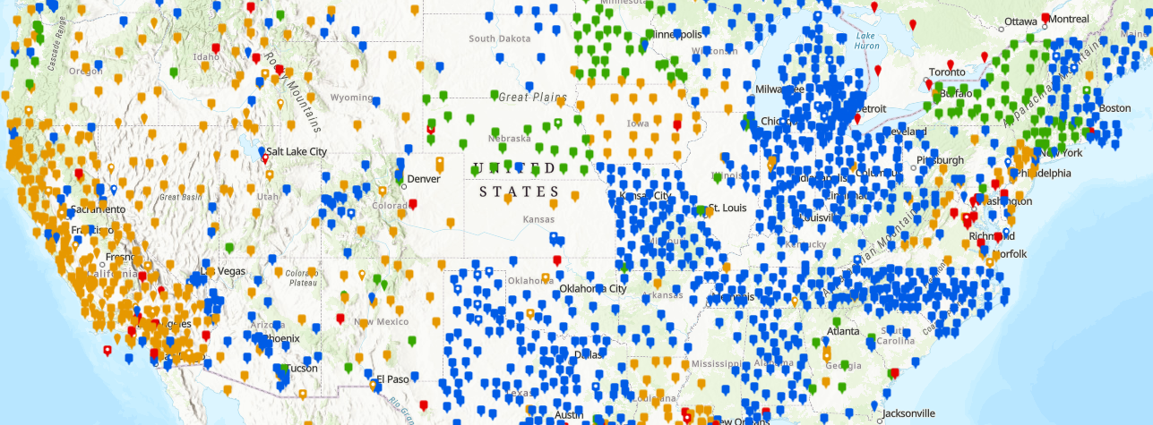
Map of NTRIP Base Stations
Refer to the NGS Map for a map of stations.
There are many more!

Slide 63
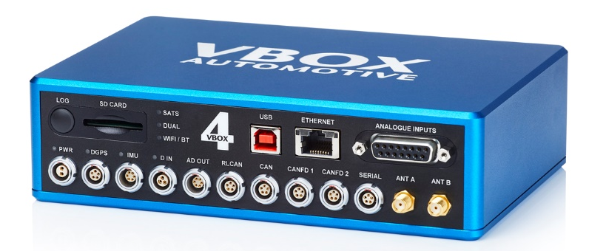
In-Vehicle Data Logger: VBOX 4
100 Hz sampling of GNSS and IMU data
RTK capable for 2cm positional accuracy
CAN bus inputs for synchronized data
Logs data to memory card
Live outputs via USB, Ethernet, CAN, Bluetooth

Slide 64

GNSS + RTK
With GNSS and RTK, we have an accurate position of the GNSS antenna on the Earth.
For most testing, we will need to know the direction the vehicle is pointing, known as its body heading. This allows us to calculate distance from a bumper, tire edge, or other point on the vehicle to a lane edge or target.
This can be achieved with dual-antenna GNSS or an IMU (Inertial Measurement Unit). Most common practice now is to use IMU integration.

Slide 65
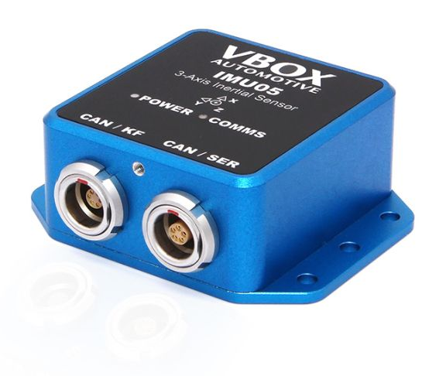
Inertial Measurement Unit
The IMU provides raw data signals:
X, Y, and Z-axis accelerations (G)
Pitch, Roll, and Yaw rates (°/s)
These channels can be used as part of
the data collected and the IMU can also
be integrated with GNSS using a real-
time Kalman Filter.

Slide 66
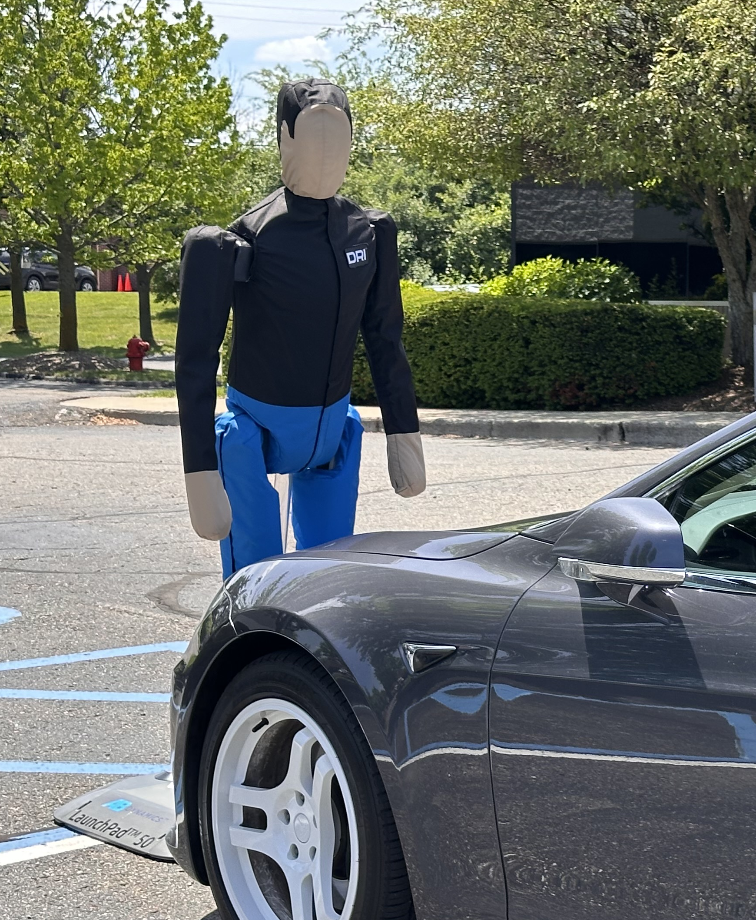
IMU Kalman Filter
IMU Integration enables three major benefits:
Measurement of body pitch, roll, and heading angles
Translation of speed and position measurements
to a different point on the vehicle:
  The GNSS antenna must be on the top of the vehicle to receive a good signal, but it may be preferable to localize all measurement to the
  center of the vehicle, center of gravity, driver
  seat, or other location.
  Resilience against dropouts due to poor GNSS reception
  This is especially helpful in urban or highway
  test environments with overpasses, tree cover,
  or nearby structures.

Slide 67
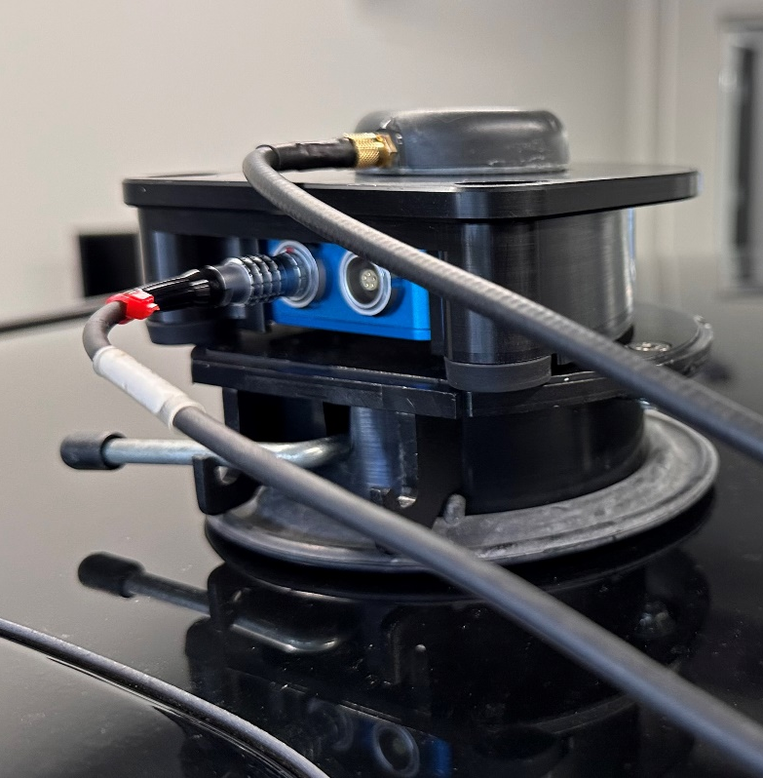
Mounting the IMU
The IMU can be mounted with the GNSS antenna on the roof for many tests. Avoid adding additional movement or vibration
from the mount if possible.
The IMU can also be mounted inside the vehicle on a strut mount or bolted onto a bracket.
If not using a roof mount, then careful measurements must be made to define the X, Y, and Z offsets between the IMU unit and the GNSS antenna.

Slide 68
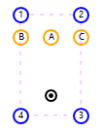
Measurement Points
With GNSS, RTK, and IMU Integration, we
have accurate information about the vehicle’s position and orientation in space, and we can configure measurement points to use one or more different points on the vehicle instead
of the GNSS antenna or IMU location.
These are done with physical measurements from the IMU location to the point of interest on the vehicle.
For an Adaptive Cruise Control test example, we would use the center of the front bumper.

Slide 69
Subject & Targets
The vehicle we have instrumented is the Subject Vehicle. This is where primary data is logged,
and all the calculations are performed. Now we
can configure one or more ADAS Objects.
There are four types of targets:
Static Targets
Target Vehicle instrumented with another VBOX
  VBOX 4 ADAS supports up to five targets in
  total, including static and moving vehicles
Lane Edges
  Straight/simple lines can be defined by 2-8 points
  Curved lane edges can be surveyed directly using
  a survey trolley
Signposts
  Up to 99 static locations can be surveyed
  The VBOX only tracks signposts within a specified field of view

Slide 70
Static Target
Most commonly a balloon car or
static dummy.
No hardware is needed on this object, just its position needs to be surveyed into the Subject Vehicle VBOX.
To survey, use a GNSS antenna on a pole and position the pole to mark the location accurately. A target heading direction can also be set by backing up 20m or more and surveying a second point to define a direction. This enables calculations based on both the static target's heading and the subject vehicle's heading.

Slide 71
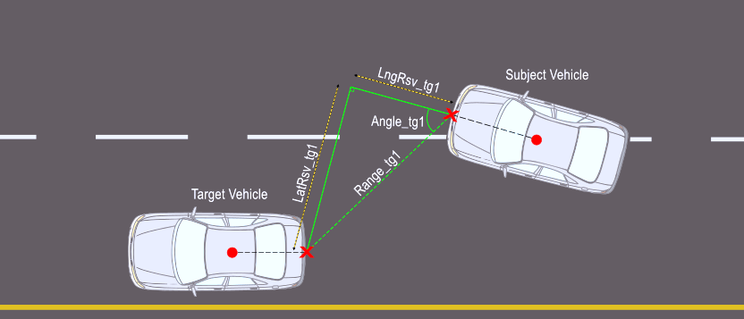
Subject/Target Vehicle Calculations
Longitudinal and Lateral Range based on Subject Vehicle heading

Slide 72
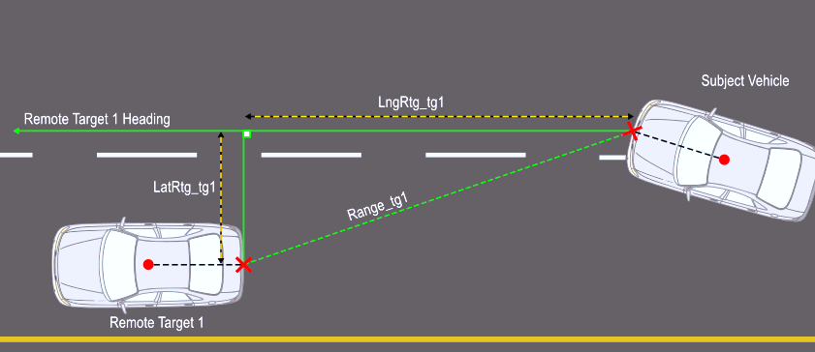
Subject/Target Vehicle Calculations
Longitudinal and Lateral Range based on Subject Vehicle heading

Slide 73
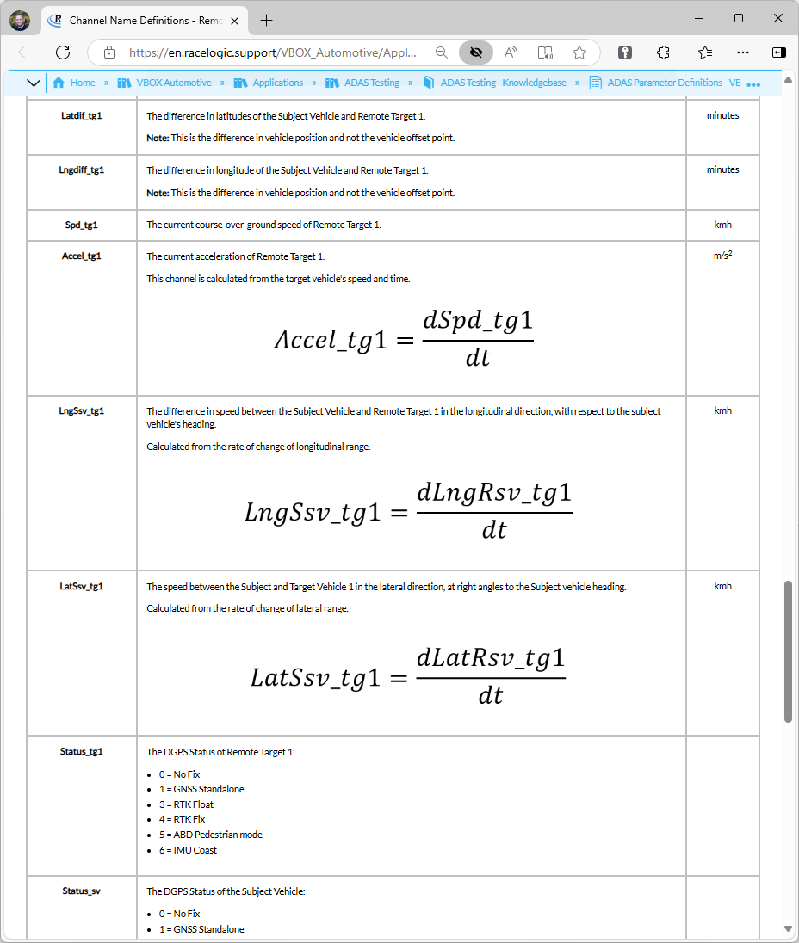
Subject/Target vehicle calculations
Other common channels:
Target Vehicle speed
Target Vehicle acceleration
Relative Speed
Time to Collision
Separation Time
Yaw Difference
Full channel list with
definitions:
Channel Name Definitions

Slide 74
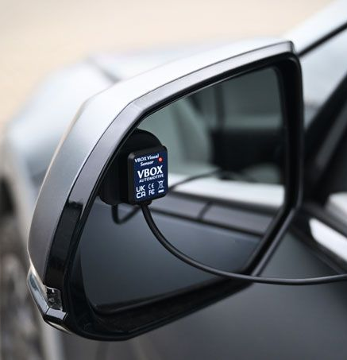
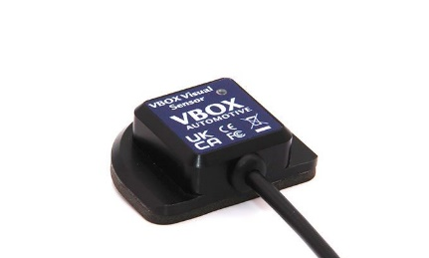
Visual Sensor
VBOX Visual Sensor can detect light activation.
Examples include a Blind Spot Monitoring indicator, FCW alert LED
or another on/off light signal.
The 5V DC output can be fed directly into the analog input of a VBOX 4 or another system like a driving robot.

Slide 75
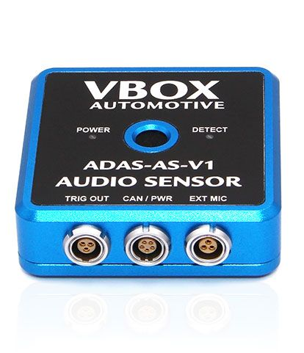
Audio Sensor
VBOX Audio Sensor detects audible alerts and transmits a CAN signal or 5V digital output when specific frequencies are detected.
To configure the alerts, audio of the specific alerts is recorded so it can be played back safely to tune the sensor. The setup software shows the frequency of alerts, and a sound level threshold is set. Up to four distinct tones can be configured at once.

Slide 76
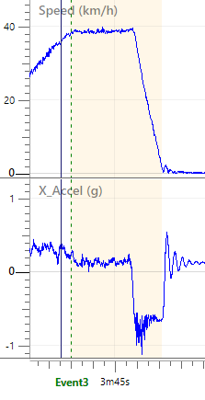
ADAS Sensors
These sensors are crucial for testing where
CAN signals are not allowed and a visual and/or audio warning must be captured in sync with the rest of the VBOX and ADAS data.
Use of either ADAS sensor marks the data at the precise moment an alert is presented, enabling
the software to automatically report data including speed, distance, time to collision, and more at the time of an alert.
This speeds up data analysis and removes the needs for manually marking events.

Slide 77
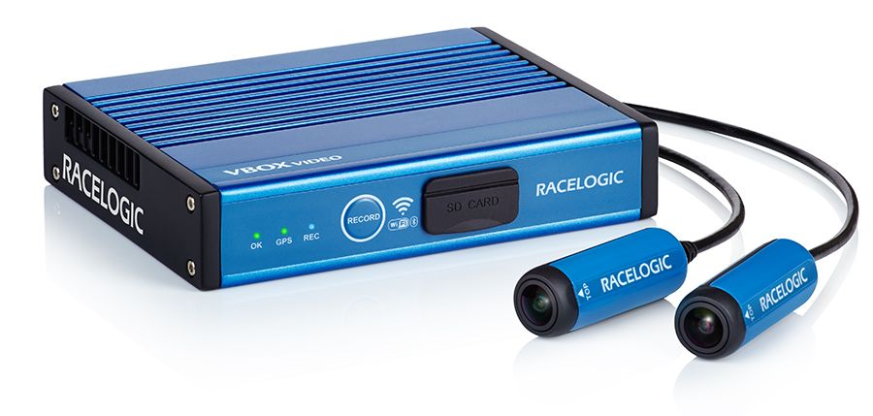
Video Logging with Data Overlay
The VBOX Video HD2 system has two 1080p cameras, GNSS, and CAN bus input. CAN input can be used to collect data directly from a vehicle CAN bus or the output from another system like the VBOX 4 ADAS.
Onboard GNSS enables time synchronization between
data collected with other
devices.

Slide 78
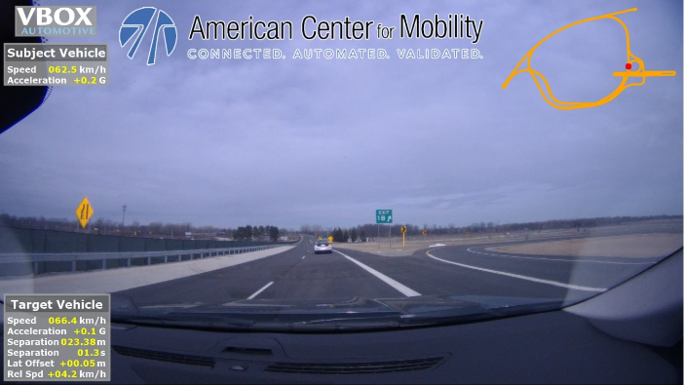
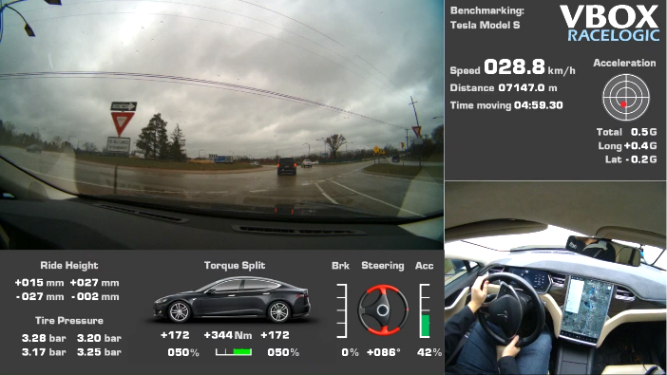
Video Logging with Data Overlay
Graphics are fully customizable to show any relevant logos, names, or test details
Users can choose text, bar graphs, gauges, and more to represent values from GNSS, IMU, ADAS Sensors, and vehicle CAN bus signals.

Slide 79
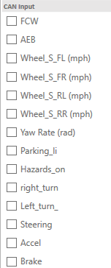
Vehicle CAN Bus Data
By accessing the vehicle CAN bus, we can record data from the vehicle’s onboard system synchronized with GNSS and IMU data. This can include steering wheel angle, accelerator and brake pedal positions, gearshift selector position, and much more. For ADAS testing, this can include ACC gap setting, and even active alerts like Forward Collision Warning and Lane Keeping. Not all signals are available on all vehicles.
The VBOX 4 has two CAN buses that can log complete vehicle CAN buses, and another that can parse this data
in real-time.

Slide 80

Overview of CAN Data
The purpose of this module is to learn how to find and use data from a vehicle CAN bus to aid in ADAS
and other vehicle testing.
Vehicles already have hundreds
of onboard sensors.
Logging data from a vehicle’s CAN is an effective way to add that data to ground truth speed, position, and ADAS data from a logger.

Slide 81
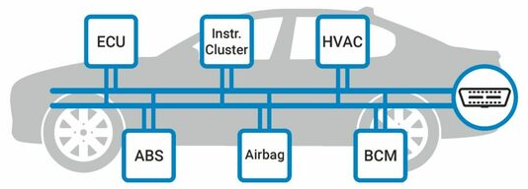
CAN: Definitions
CAN stands for Controller Area Network
Like a LAN for a network of computers, this system allows multiple sensors and modules around a vehicle to communicate over a shared bus rather than through individual wires.

Slide 82
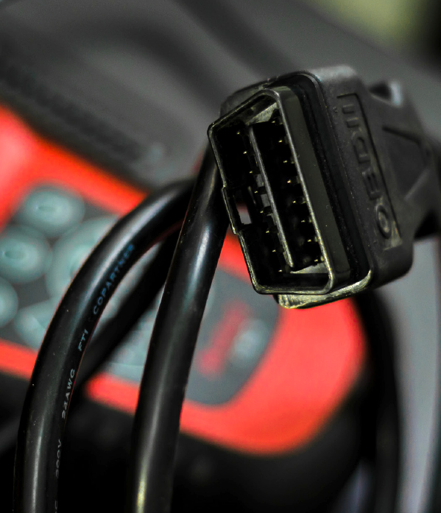
Diagnostic CAN
Diagnostic CAN or PID-CAN is a protocol where a device sends a request to the vehicle, and it sends a reply. This is used
for emissions testing and OEM-specific devices like Techstream.
Diagnostic modes have limited bandwidth and response time and are not typically used for vehicle testing.
They are generally focused on engine data,
so data like steering angle, wheel speeds, brake pressure, or ADAS settings may not
be available.

Slide 83
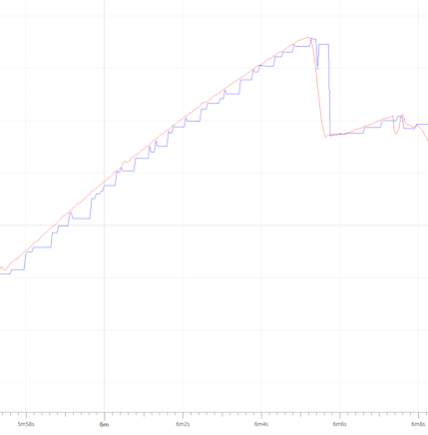
High-Speed CAN
High-speed CAN is the standard functionality where a specific module like the ABS controller transmits wheel speed data onto the vehicle’s CAN bus constantly and at a high rate. Often this is between 20 and 100 Hz. This is what is used for testing, as the data logger can read these signals as quickly as the vehicle’s onboard systems.

Slide 84
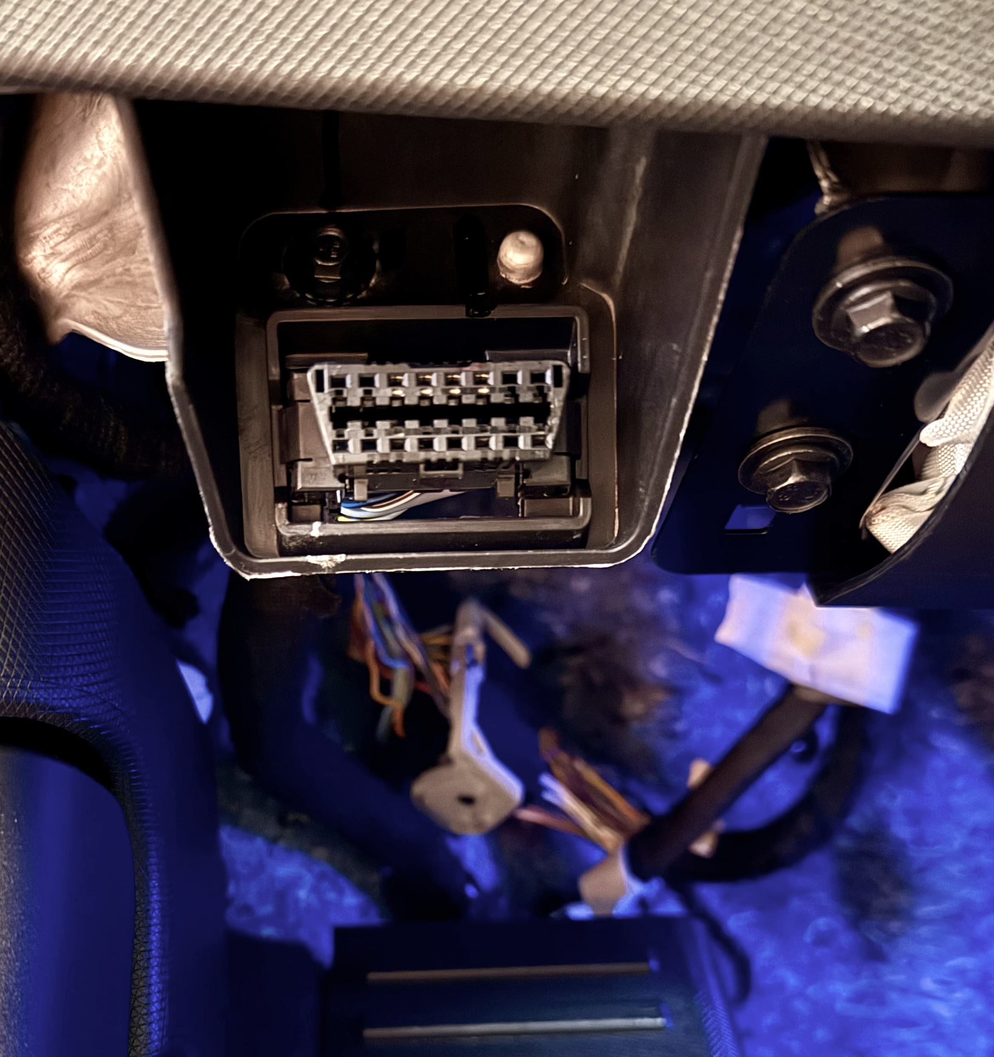
Where to Access the CAN Bus:
OBD Port
Best chance for success on American
and Asian vehicles ~2004-2018
Never used by BMW or VW/Audi/Porsche vehicles
No longer available in many vehicles starting in model year 2018 due to increased security requirements

Slide 85

Where to Access the CAN Bus:
Twisted Pairs
Even with no useful data on the OBD port, almost all modern vehicles use CAN bus, and it can be accessed by tapping directly into vehicle wiring.
To find the wiring, start in an area where a lot of vehicle wiring comes together, and it is easy to access like the base of the A-pillar on the passenger side of a vehicle.

Slide 86


Tools: Pomona Probes
Pomona Insulation Piercing Clip Set
Quickly probe twisted pairs to find vehicle
CAN buses
Banana connector on back to connect to
CAN interface

Slide 87

Tools: Posi-Tap Connectors
Posi-Tap- No Crimp Tap (20-gauge size)
This tap holds each wire in place, and a needle point is screwed into the wire to penetrate the insulation and contact the
wire inside.
A new wire can be connected to the
back of the tap to feed CAN bus data
to the CAN bus reader or data logger.
When removed, only leaves a tiny
hole in the wire insulation.

Slide 88
Notes of Caution
Avoid transmitting data onto a vehicle
CAN bus
If the vehicle’s onboard systems are working properly, then its CAN bus is complete, and all nodes are communicating properly
Connecting a device at a different baud
rate or adding additional traffic to the CAN bus can cause communication errors and “confuse” the vehicle’s systems
Disconnecting CAN wiring within the vehicle’s CAN network can also cause onboard systems to fail

Slide 89

Ready to Test!
We can view data by removing the memory cards from VBOX 4 ADAS and VBOX Video HD2 and opening them in VBOX Test Suite software.
More details on the data analysis and report generation can be found in the module Overview of VBOX Test Suite for analysis.

Slide 90
Any Questions?
Notes:
Any questions?

Slide 91

Module Summary
List the steps involved in collecting Advanced Driver Assistance Systems (ADAS) test data, including instrumenting vehicles and logging data to a memory card for further analysis.​
Recognize technologies such as GNSS, RTK, and IMU used in vehicle data acquisition, including the capabilities and configurations of the VBOX 4 and associated sensors.​
Describe how to set up the equipment and integrate data from vehicle CAN bus, GNSS, and other sensors to facilitate accurate testing and analysis, including video logging with data overlay.​
Notes:
Module Summary
Adjust text & re-size black box as needed. Center vertically.

Slide 92
Any Questions?
Notes:
Any questions?

Slide 93

Module 4
Overview of VBOX Test Suite for Data Analysis
Notes:
Section title

Slide 94
Module 4 Objectives
Utilize the VBOX Test Suite software for analyzing ADAS test data collected with
VBOX loggers, including live viewing and
post-processing of data files.​
Create, configure, and analyze custom tests using the software, defining start and end conditions for repeatable data analysis to obtain meaningful test results.​
Demonstrate how to export test results and raw data into CSV or text files for further analysis and integrate the findings into spreadsheets to build comprehensive
reports​​.
Notes:
Module Objectives

Slide 95
Overview of VBOX
Test Suite for Analysis
This module is for analyzing ADAS
test data collected with a VBOX logger using VBOX Test Suite software.
We start with one or more memory cards with files and end with useful test reports in a spreadsheet or
a similar format.

Slide 96

VBOX Test Suite
VBOX Test Suite is available as a
free download from Racelogic.
There is no cost to use the software, or restrictions on the number of users. It is designed to be used
with data files collected from VBOX loggers.
The tool is used for live viewing
and post-processing.

Slide 97
Data File Organization
Before loading files for analysis, they should be organized to avoid errors.
The VBOX data file includes details like the unit serial number, date and time recorded, and speed and position data, but does not reflect what vehicle it was in, who was driving, or what test was intended to be recorded.
Taking notes of the file name during
the testing will help streamline file organization and analysis.

Slide 98
Data File Organization
My recommendation: folder for the project, subfolders for test sets.
For Video Synchronization, VBOX Test Suite requires that the VBOX 4 VBB data file, VBOX Video VBO data file, and MP4 video file are in the same folder. Data files can be renamed but video files cannot.
The video file is a standard mpeg-4 format and
can be used in presentations, online sites, or brought into a video editing tool to be combined with other video content. No specific software
is needed to use the video file.
The data files are designed to be used specifically with VBOX software tools but can be converted
to CSV or imported to MatLab.

Slide 99

Workspace
Load a file into VBOX Test Suite. Start with the primary file, usually from the VBOX 4 ADAS. This will show the file in a Workspace view.
This view shows the dashboard across the top, with large displays of speed, satellites, and UTC time by default. These can be customized for live viewing when used “online” with the VBOX.

Slide 100

Workspace: Map
For post-processing data, the dashboard can be closed to give
more room to show the chart and
map views.
The map shows a north-up view of
the path the vehicle followed, and the background can be replaced with an aerial image or map view using tools
in the Map tab.

Slide 101

Workspace: Chart
The display shows speed by default. Additional channels can be added using tools in the Chart tab.
This example shows speed, longitudinal acceleration, and
distance from the subject vehicle to target for a pedestrian AEB test.

Slide 102

Workspace: Video Sync
If data is recorded alongside synchronized video using a VBOX Video, we can use the “Video Sync” option in the File menu to bring that in as well.

Slide 103

Workspace: Video Sync
This prompts us to choose the VBO file taken at the same time as the VBOX 4 data.
Since both devices have GNSS engines, accurate time stamps are shown here, and the speed data is graphed together to confirm that this data was from the same vehicle at the same time.
The files do not need to start and stop
at the same time, but there must be overlap in the recordings to use Video Sync.

Slide 104

Workspace: Video Sync
Now the software shows 100Hz
VBOX ADAS test data alongside the synchronized video from the HD2. The GNSS data from the HD2 is still available in that VBO file but not used further in this analysis.
As we move the cursor along the chart or click a point on the map, the software shows the corresponding frame of video.
We can also click the video to play it, and the chart and map will follow in
real-time.

Slide 105

Chart: Measure Tool
Quick measurements can be performed on this data by positioning the cursor at the beginning of an area of interest and clicking add marker
from the Chart tools.
Then, add a marker at a
second point and click the Measure tool.

Slide 106


Chart: Measure Tool
The Measure tool shows the elapsed time, distance, and any other channels that are selected on the chart in a table of data, including values at the start
and end of the selection, as well as the difference, maximum, minimum, and average values for each channel.
This is a useful way to quickly open a
file and get some data from it without defining a repeatable test.

Slide 107

Custom Tests
If the start and end of a test can be defined and repeated, VBOX Test Suite offers more tools to quickly analyze data using those.
For standard tests like acceleration and braking time and distance tests, built-in presets can be used.
For ADAS testing, the Custom Test is used as it offers the most flexibility.
Tests are defined by a start condition – what starts our test, and an end condition – when is the test complete.

Slide 108
Custom Tests: Examples
Start when audible alert occurs, end when vehicle speed is zero.
Can be captured with VBOX ADAS Audio Sensor.
Can be marked as an event by reviewing the video and its audio.
Start when crossing a position on track, end after 10 seconds.
Start when blind spot indicator
is on, end when blind spot indicator is off. Can be captured with VBOX ADAS Visual Sensor
Start when vehicle starts
moving (Speed >0), end
when Subject vehicle passes Target (LngRsv-tg1 >=0).

Slide 109

Custom Test: AEB
For this example, we will configure the test to start at a marked event and end when vehicle speed is zero.
By choosing to start by Event Type in the Event field and not a specific event, this test will work on any file with a marked event, or multiple marked events in one file.

Slide 110

Custom Test: Test Results
Upon closing Test Setup,
VBTS will scan the file to find any occurrences where the
start and end conditions are met.
A line of data is shown in the Test Results area, and the
test is highlighted on the
chart and map.

Slide 111

Custom Test: Multiple Runs
If there are multiple test
runs in the file(s) that are
open, they will each be
assigned a different color
in the list and highlights.

Slide 112

Custom Test: Run Compare
By default, all the runs are shown sequentially over time.
To compare test runs directly, choose Run Compare on the Chart toolbar to see the four runs from this test set aligned based on their start condition
of the audible alert.

Slide 113

Custom Test: Test Result Columns
The Test Results area can be customized to show the channels
of interest by right-clicking on the column headers.
This allows us to choose which channels to show in each column, and whether to show data at the start or end of a test.
We can also choose to see the data from start to finish, maximum or minimum values, or an average or standard deviation of a given parameter.

Slide 114

For this test we show results for the following:
Run number
Elapsed time
Distance traveled
Longitudinal Distance from Subject to Target at the start of test (audible alert active)
Time to collision at start of test
Speed at start of test
Longitudinal Distance from Subject to Target at the end of test (vehicle stopped)

Slide 115


Export Raw Data
Using Save Run As, we can export the 100Hz raw data for just this run as a new VBO or CSV file.
A VBO file would be used to share this data with another user with VBTS software. CSV can be used to analyze data in tools like Excel, or others.

Slide 116

Copy to Spreadsheet
The most common practice is
to build a spreadsheet of test results and copy results directly from the Test Results table
into Excel.

Slide 117
Any Questions?
Notes:
Any questions?

Slide 118
Module Summary
VBOX Test Suite offers a Workspace view to quickly see what data is contained in a data file, take screenshots, quick measurements, and screen recordings.
Using Custom Tests, consistent tests can be configured and run across multiple data files to create results tables and export cropped runs for further analysis.
Notes:
Module Summary
Adjust text & re-size black box as needed. Center vertically.

Slide 119

Question:
What are the most valuable things you’ve learned today?
Notes:
Question

Slide 120

Course Closing & Evaluation
Notes:
Now let’s recap the full course.

Slide 121
IACET Accreditation
SAE International is an Accredited Provider of the International Accreditors for Continuing Education and Training (IACET). By holding this accreditation, SAE demonstrates compliance with the ANSI/IACET 2018-1 Standard for Continuing Education and Training, which is recognized internationally as a proven model for quality continuing education and training practices. SAE is authorized to offer IACET CEUs for Professional Development learning programs that meet the criteria outlined in the ANSI/IACET Standard.
The Continuing Education Unit (CEU) was created by IACET as a measurement of continuing education. One (1) IACET CEU is equal to ten (10) contact hours of participation in an organized continuing education experience under responsible sponsorship, capable direction, and qualified instruction. Under IACET's care, the IACET CEU has evolved from a quantitative measure to a hallmark of quality training and instruction. For more information on IACET, visit www.iacet.org.
To obtain official transcripts, please contact SAE Customer Service at 1-877-606-7323
(U.S. and Canada only) or 1-724-776-4970 (outside U.S. and Canada).
121

Slide 122
Learning Assessment
SAE Professional Development Seminar participants have an opportunity to earn Continuing Education Units (CEUs) by participating in and completing all course requirements, including an online learning assessment with a passing score of 70% or higher.
The assessments feature multiple choice questions randomized from a bank of questions, randomized answer choices, standard feedback for correct answer choices, custom feedback for incorrect answer choices, and a summary page reflecting the learner’s results and an opportunity for review.
122

Slide 123
Certificates
After course completion, you will receive access to print your certificate.
A Certificate of Attendance is awarded to each student who completes attendance requirements.
  A Certificate of Achievement is awarded to each student who completes the attendance and course requirements, and scores 70% or higher on the post-course learning assessment.
123

Slide 124
Seminar Evaluations
The Course Evaluation and Learning Assessment will be available in the SAE Learning Center. You will receive an email invitation upon course completion with instructions and will need to complete both items in order to access the Certificate of Achievement in your SAE Learning Center account.
124

Slide 125
Certificate Programs
Gain Industry Recognition for Your Professional Expertise
SAE offers several options to earn credentials beyond your university degree(s) that can enhance your resume and further advance your career. More information available: https://www.sae.org/learn/professional-development/certifications
Browse Certificate Programs by Topic:
Accident Reconstruction
Management and Leadership
Product Engineering Tools and Methods
Vehicle Dynamics
125

Slide 126

Professional Development Resources and Support
Explore the full portfolio of training courses with our interactive Professional Development Education and Training Course Catalog:
Professional Development Education and Training Course Catalog
Should you have questions regarding any SAE International seminar, please contact us at mylearnsupport@sae.org
Thank you for attending!
Scan to view
the online
course catalog
126

Slide 127

Notes:
End cap
Add/change background image using Design < Format Background

